Slide 1

CEIR Lawful Agency - Training Manual

Slide 2

Agenda
Product Overview
Lawful Definition and Overview
Assumptions
Features
Stolen
Single Device
Bulk Device
Recovery
Single Device
Bulk Device
Grievance

Slide 3
Lawful Agency - Definition
Lawful agency is a government department of Cambodia to manage stolen devices list on the CEIR system
Any end user or stakeholder who wish to report stolen / recovery cases should visit lawful agency office and intimate them

Slide 4
Overview
Lawful Agency has to register using DMC Home Portal
As part of registration process, Lawful Agency will receive the username and password which can be then used to login to the CEIR Portal
Once logged into the CEIR portal, Lawful Agency can use following features
Report Stolen Device
Report Recovered Devices
Grievance
Profile Management
Lawful Agency can see the status of ongoing activity through the Dashboard feature
Email Notification to keep track of the status of various operations

Slide 5
Assumption
Only Lawful Agency has the right to mark the devices as stolen /recovered with due verification and upload on the CEIR portal.
Any end user or stakeholder who wish to report stolen / recovery cases should visit lawful agency office and intimate them

Slide 6
Registration – Lawful Agency
A Lawful Agency has to be a Government Company.
An Employee from lawful agency organization will register on the CEIR portal
During registration, employee has to share the details of the reporting manager.

Slide 7
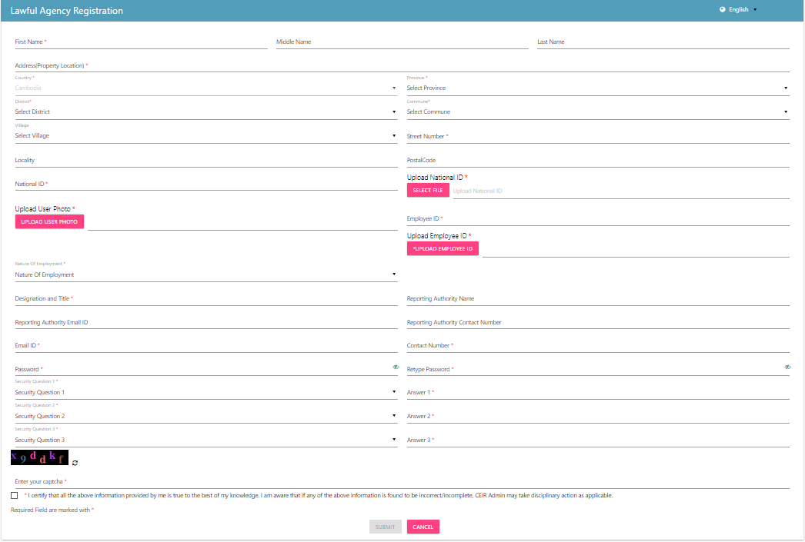
Registration – Lawful (Form)

Slide 8
Dashboard – Lawful Agency
The Dashboard has information about the following
Total number of stolen/recovery request
Total number of devices stolen/recovered
Total Grievances raised by the Lawful Agency
Notifications on feature requests raised by the Lawful Agency

Slide 9
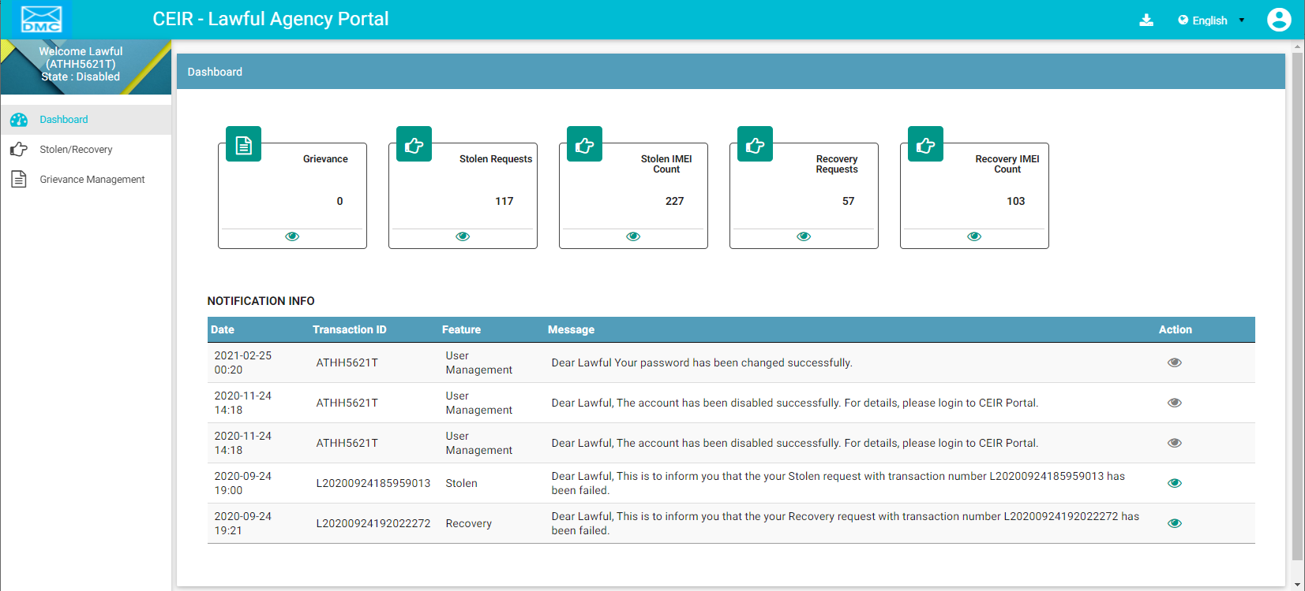
Dashboard – Lawful Agency
Download User Manual
Left Panel
Work Area
All features status
Edit Profile
Language Change
On click it takes user to respective home page
Notifications

Slide 10
Lawful Agency – CEIR Interface

Slide 11
Stolen/ Recovered Device
Two Cases
Single Device
Bulk Device
While reporting stolen cases, the following information is required
Device Information
Personal Information
Place of Stolen/Recovery Devices

Slide 12
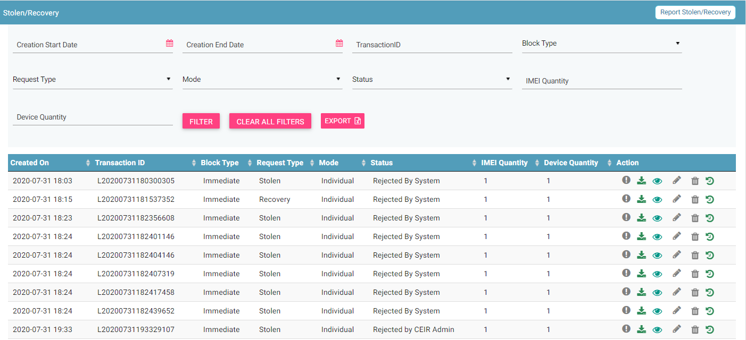
Stolen/Recovery
Report
Filters
Export
Action like Download ,View, Edit, Delete, History
View All requests

Slide 13
Grievance – Lawful Agency
As an operator, you can register grievances when there is a problem in the CEIR system.
For example, there could be situations when the registration feature is not working or there could be a problem in downloading grey list file from CEIR portal.
Once a grievance is raised, it reaches the CEIR Admin queue for response from CEIR Authority.
CEIR Admin can ask for more details in case required.
Else CEIR Admin will respond and close the grievance.

Slide 14
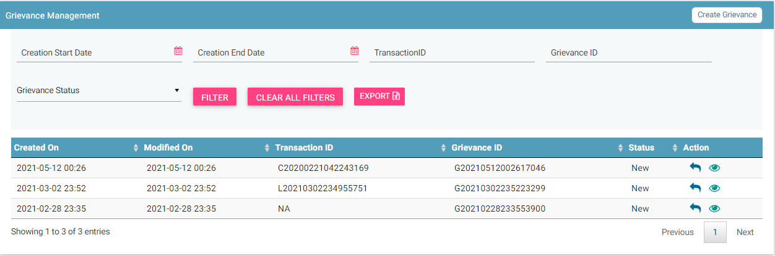
Grievance – Lawful Agency
Report
Filters
Export
View All grievances
Action like View, Reply

Slide 15
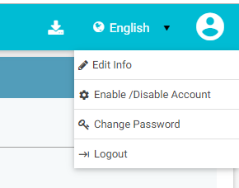
Profile Management

Slide 16
Queries

Slide 17
Thank You

